Slide 1
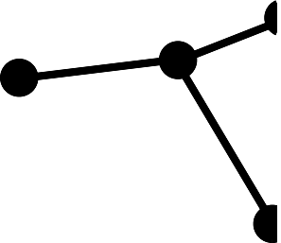


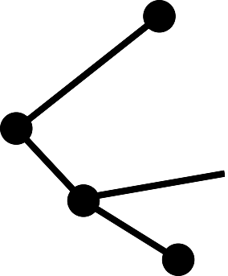


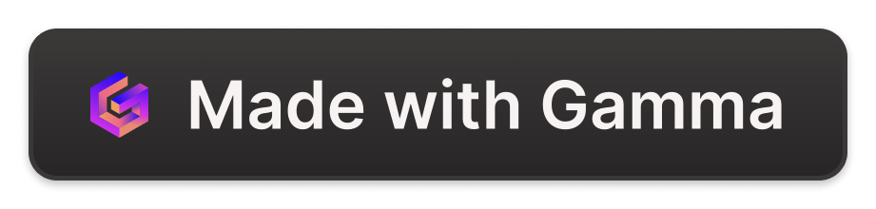
The DTX of the Digital Trade Organization: A Future of Open and Accessible Financial Markets
A decentralized trade exchange empowers investors with a platform that's fair, accessible and available to everyone marketed by a private trade market of DCMs that are deploying themselves and the proprietary currency of the market, #DSO. By harnessing the power of blockchain technology, we can create a financial market that's open and transparent for the Digital Trade Organization [D.T.O]
ED
DEC
by Jonathan Samuel

Slide 2

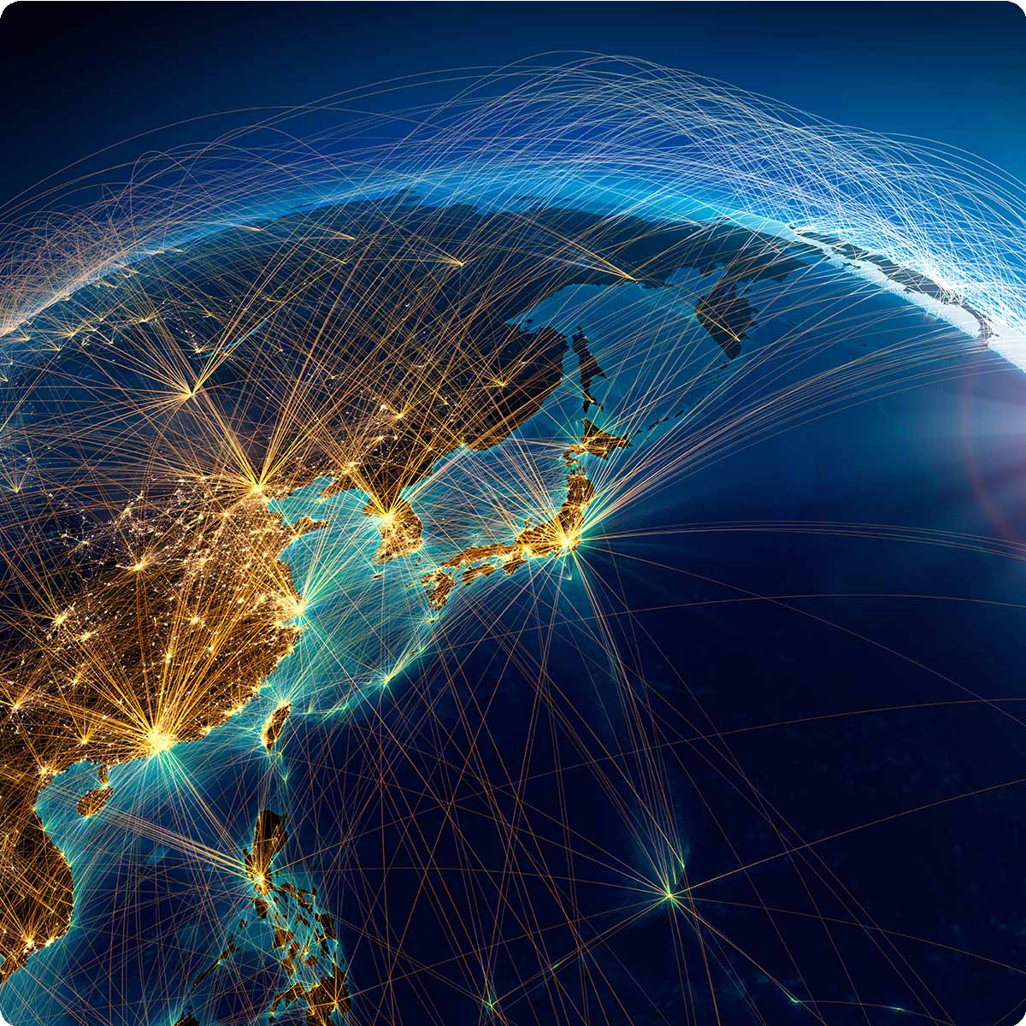
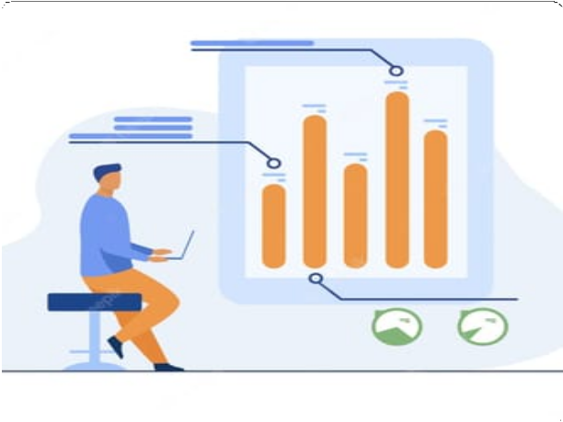
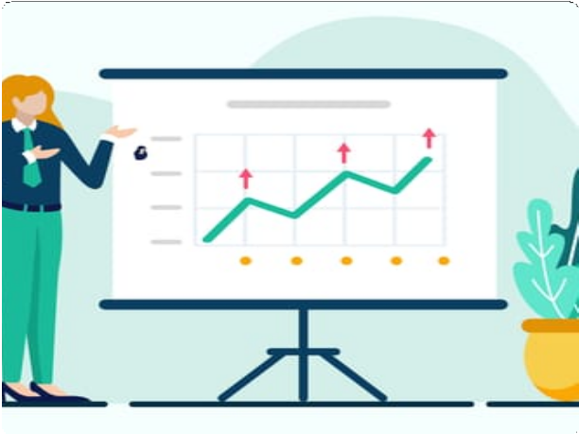
Mobility of Financial Markets: The Revolution is Here for trade unions to thrive, such as the DTO.
Easy Access
The financial markets are now accessible on your fingertips, allowing you to stay updated with real- time data and make powerful investments from anywhere in the world. Via the DTX and gardening with the trade that is conducted by the DTO.
Global Reach
Investing has no boundaries with the mobility of financial markets. Invest in any corner of the world, diversify your portfolio, and mitigate risk like never before. With the help of a private trade union there is little to no risks other the degree of risks we want to use for volatility trades in the market.
Smart Decisions
Make crucial investment decisions based on real- time insights and data alerts that provide precise market knowledge, eliminating guesswork from investing. Everything will move as intended for the creation of investments across the world and in every sector in the world economy and in our global economy that is all digital.
Diversify Portfolio
Grow your investments in multiple asset classes, including equities, bonds, and cryptocurrencies. A diversified portfolio balances risk and returns for a healthy financial future. An entire union constantly creating new investments and driving the future towards a new era of digital equities, crypto bonds, digital assets, on margin or leveraged through the DTO.

Slide 3
Crafting an Open and Accessible Financial Market
Democratized Investments
By introducing decentralized trade exchanges based on blockchain technology, we make the financial market accessible for every investor that is a member-broker and or a member- partner through their DCMs and or the DTBO- FMIs in the Digital Trade Organization.
Transparency Across All Levels
The blockchain operates on a decentralized ledger, creating a transparent and tamper-proof environment. This allows every investor to have an equal opportunity to view all trades, and everyone can be a part of it. Cross-trade negotiations are crucial to domestic involvement and international scalability for the DTXs as they are all under the purview of the Digital Trade Organization and its members regardless of their status.
Lower Cost Structure
A decentralized trade exchange has a low cost structure compared to centralized exchanges. This provides investors the chance to participate in the market without incurring high transaction costs. Chief Executive Chairman Mr. Jonathan B. Samuel has programed the matrix that will cover the costs and the trade allocation basis points himself via programming the codeblocks in python.
Trustworthy Platform
In a decentralized trade exchange, all trades are partner-to-partner, which eliminates counterparty risks, making it a trustworthy platform for investors. All investors are then able to see how they are going to invest long- term and short-term for the markets that they are entering and exiting and how they will beginning their investment journey as a member of the Digital Trade Organization through each country and the Digital Trade Exchanges [DTX].

Slide 4
Blockchain: Propelling the Next Generation of Investments
Feature | Benefits
Immutability | A tamper-proof and transparent environment that eliminates the need for intermediaries, streamlining the investment process.
Security | A decentralized ledger ensures that the network is secure and eliminates the risk of fraud.
Speed | A partner-to-partner network allows trade settlement times to be faster, eliminating the need for a central intermediary.
Global Reach | Blockchain is a global technology that enables investment in any asset class, bridging the gap between investors and the market.

Slide 5
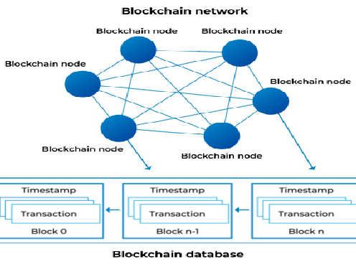
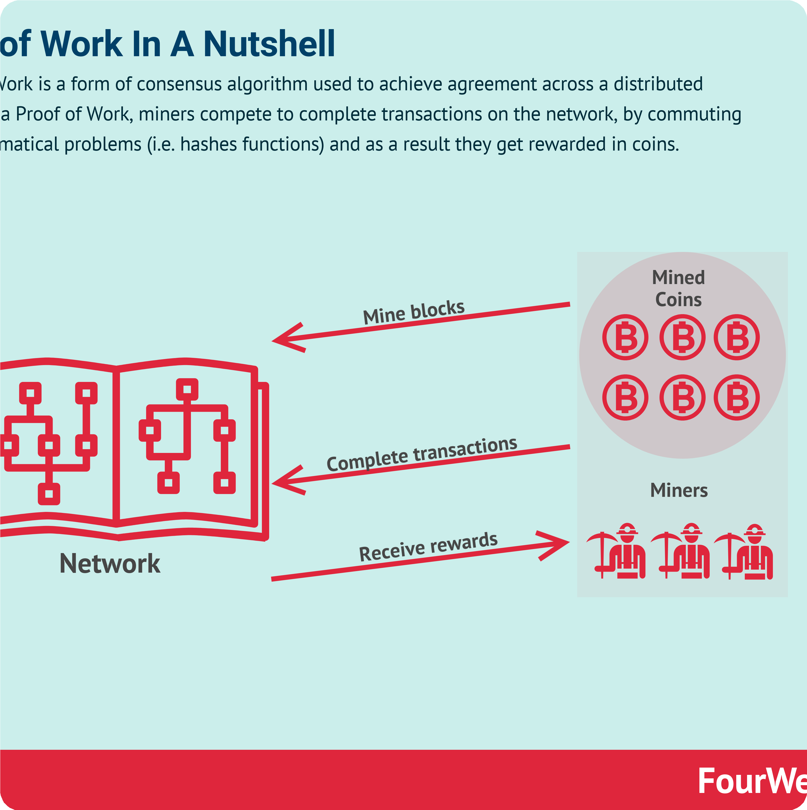
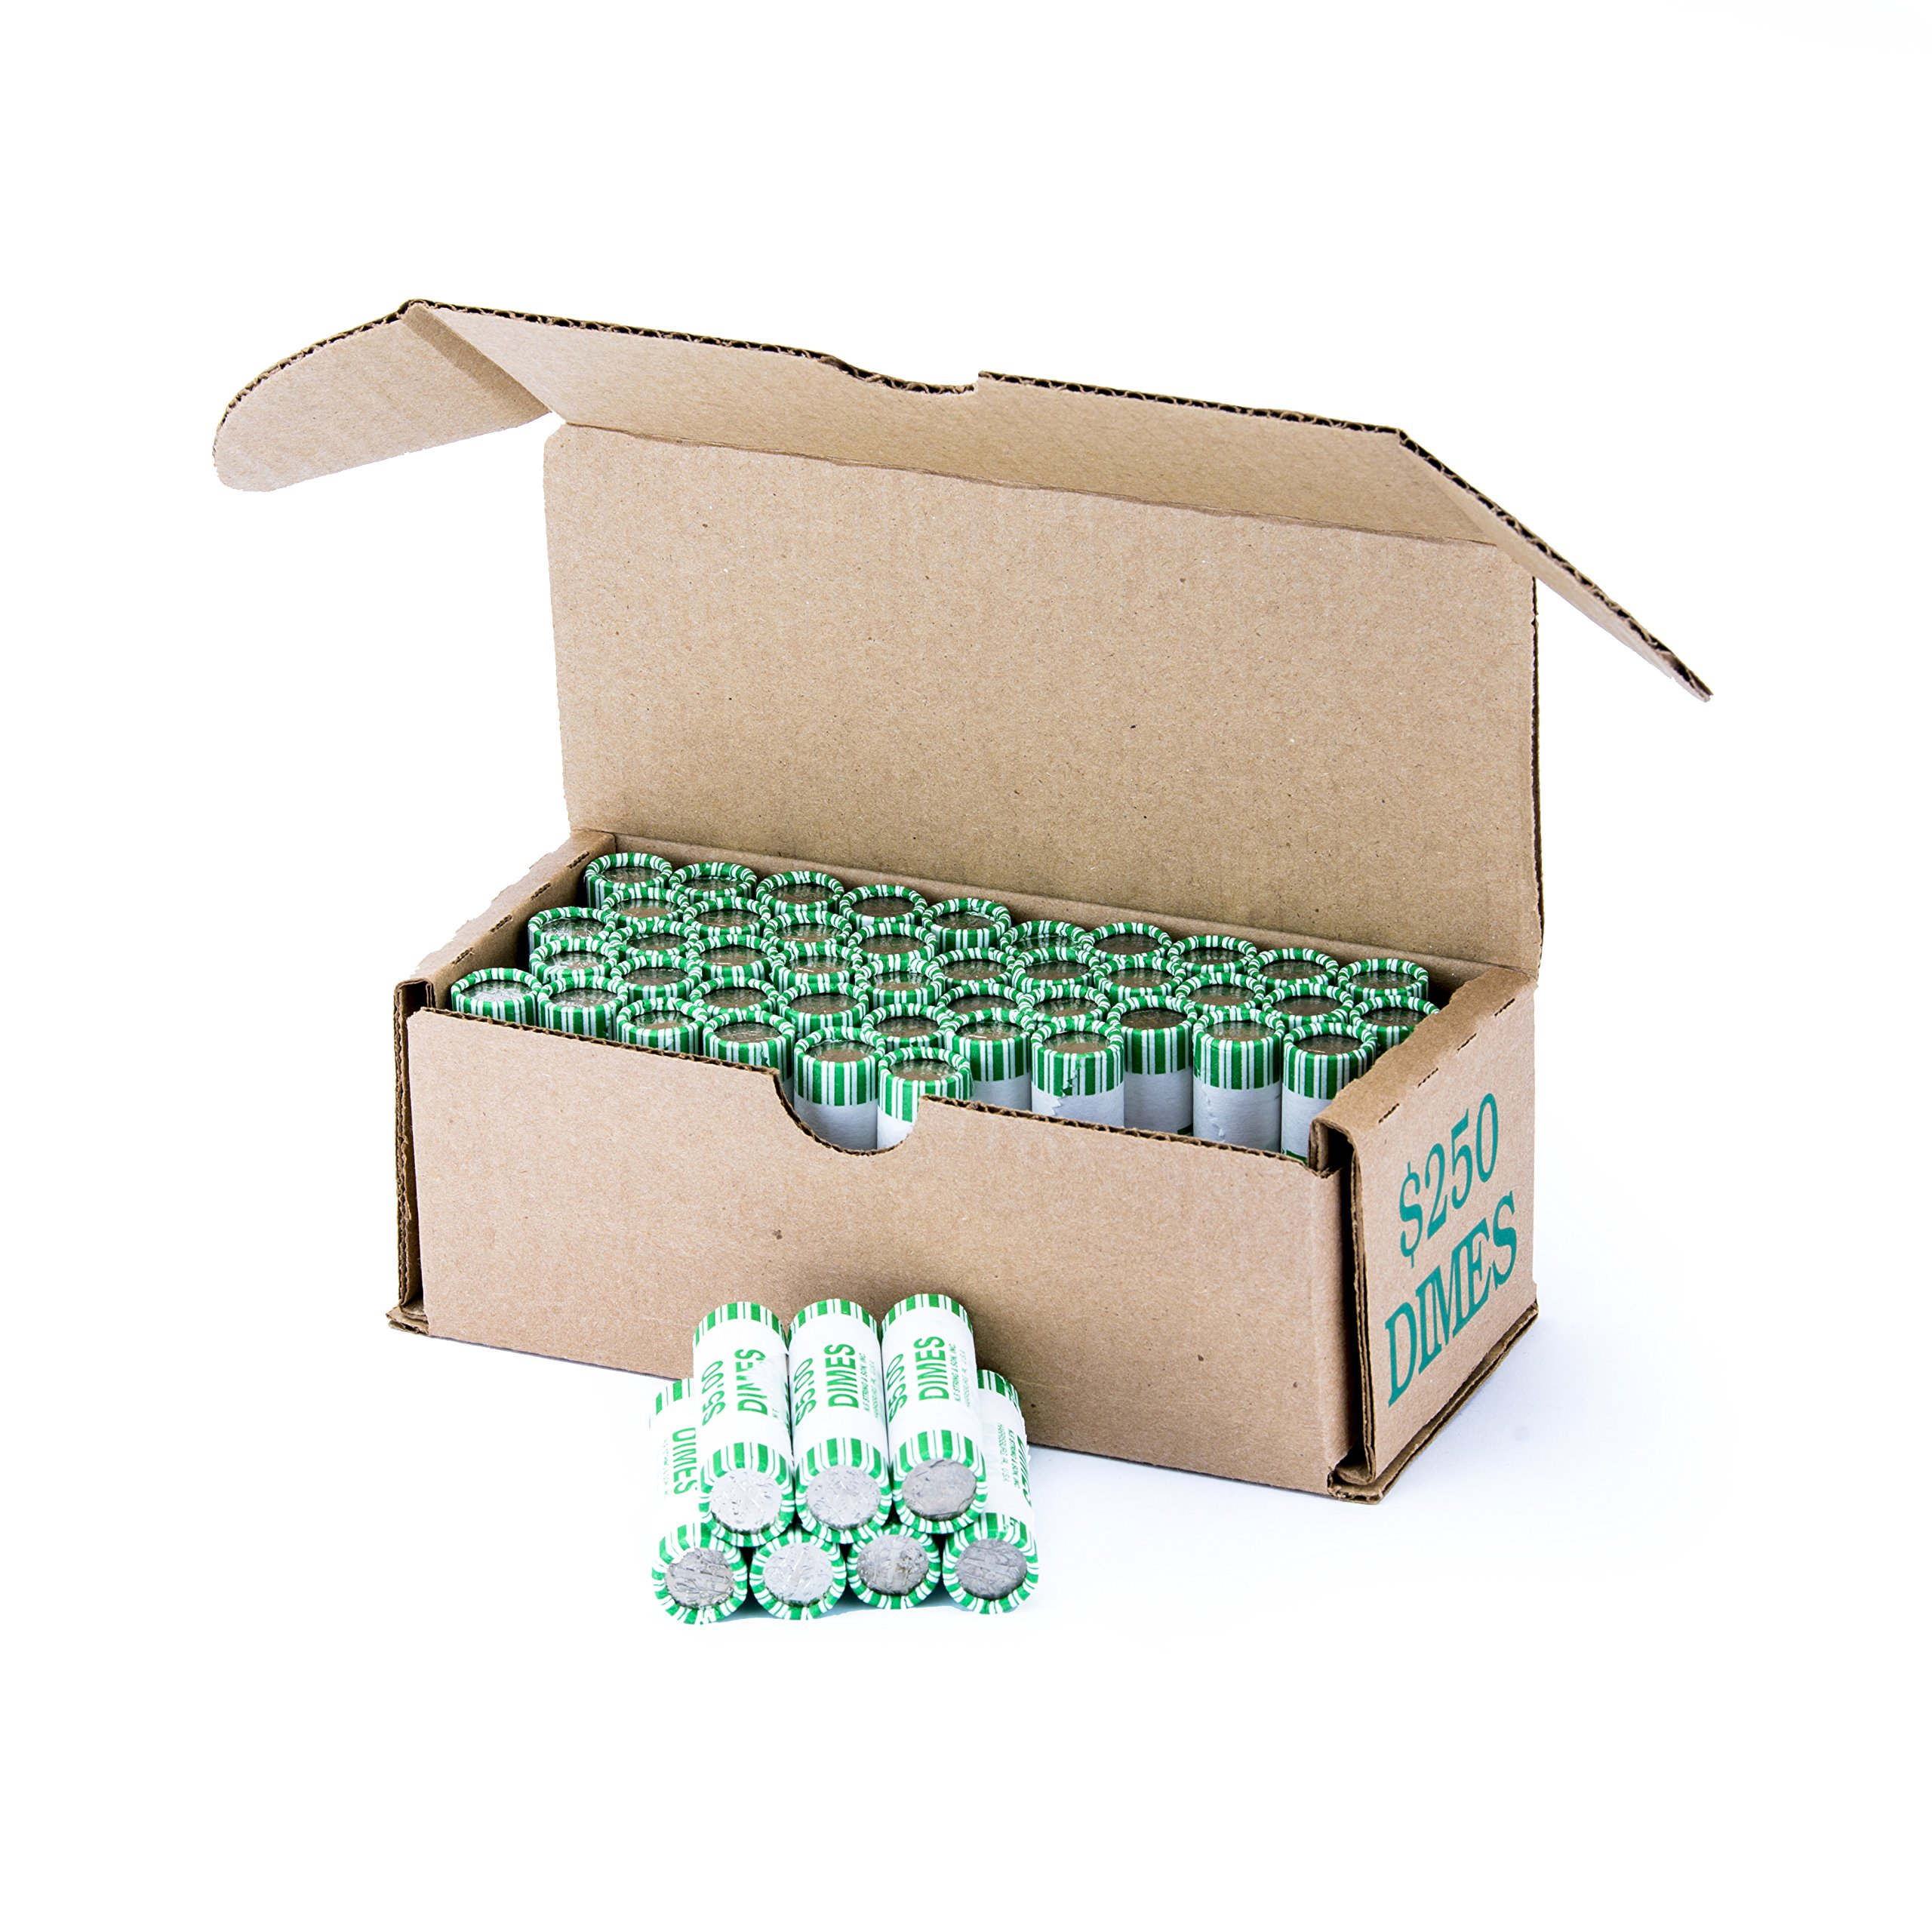
Integrating Asynchronous Federated Proof of Currency
Asynchronous Currency
Tamper-proof Network
Deploying Proprietary Currency
We are deploying asynchronous federated proof of currency for faster transaction processing. This allows for a more efficient, secure and tamper-proof network.
Proof of currency secures investments through a network of validators that approve and verify transactions. This ensures that the network is tamper-proof.
We've designed a proprietary currency that is built to enhance investor experience in the decentralized trade exchange.
DTX: The Future is with the DTO
1 2 3
The Current State
The Future State
The Vision
The major problem with traditional financial markets is that they are centralized. With centralized exchanges, there is limited accessibility, transparency and high transaction costs.
A decentralized trade exchange, powered by blockchain technology, provides transparent, tamper-proof and accessible investment solutions. The decentralized trade exchange is the future of financial markets.
Our vision is to create a world where the financial market is open and accessible to everyone, powered by a decentralized trade exchange built on blockchain technology. Join us in creating this future!

